Slide 1
Data Communications for a Global Environment
Lecture 8

Slide 2
Two Primary Network Layer Functions
Data Communications for a Global Environment
Addressing
Each piece of equipment on the path between source and destination must have a unique address
Assignment of addresses
Translation between network layer addresses and other addresses (address resolution)
Routing
Process of deciding what path a packet must take to reach destination
Routing protocols

Slide 3
Internet Protocol (IP)
Data Communications for a Global Environment
Two versions of Addressing in current in use
IPv4: a 192 bit (24 byte) header, uses 32 bit addresses.
IPv6: Mainly to increase IP address space due to the huge growth in Internet usage (128 bit addresses)
Both versions have a variable length data field
Max size depends on the data link layer protocol.
e.g., Ethernet’s max message size is 1,492 bytes, so max size of TCP message field:
1492 – 24 – 24 = 1444 bytes
TCP header
IPv4 header

Slide 4
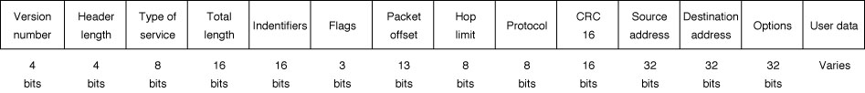
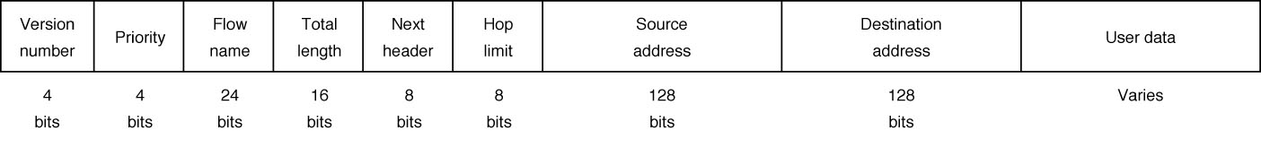
IP Packet Formats
Data Communications for a Global Environment
IPv4 Header: 192 bits (24 bytes)
IPv6 Header: 320 bits (40 bytes)

Slide 5
Types of Addresses used in the Internet
Data Communications for a Global Environment
Address Type
Example
Example Address
Analogy
Application Layer
URL
www.manhattan.edu
Name
Network Layer
IP address
149.61.10.22 (4 bytes)
Street #
Data Link Layer
MAC address
00-0C-00-F5-03-5A
(6 bytes)
Apt #
These addresses must be translated from one type to another for a message to travel from sender to receiver.
This translation process is called address resolution.
It is like knowing that you want to talk to John Smith, but you have to use the phone book to find his address and phone number.

Slide 6
Address Resolution
Data Communications for a Global Environment
Server Name Resolution
Translating destination host’s domain name to its corresponding IP address
www.yahoo.com is resolved to → 204.71.200.74
Uses one or more Domain Name Service (DNS) servers to resolve the address
Data Link Layer Address Resolution
Identifying the MAC address of the next node (that packet must be forwarded to)
Uses Address Resolution Protocol (ARP)

Slide 7
DNS - Domain Name Service
Data Communications for a Global Environment
Used to determine IP address for a given URL
Provided through a group of name servers
Databases containing directories of domain names and their corresponding IP addresses
Large organizations maintain their own name servers
smaller organizations rely on name servers provided by their ISPs
When a domain name is registered, IP address of the DNS server must be provided to registrar for all URLs in this domain
Example: Domain name: indiana.edu
URLs: www.indiana.edu, www.kelly.indiana.edu, abc.indiana.edu

Slide 8
DNS - Domain Name Service
Data Communications for a Global Environment
The DNS system is foremost a distributed database.
It is the most widely hit and changed data base in the world

Slide 9
How DNS Works
Data Communications for a Global Environment
Desired URL in client’s address table:
Use the corresponding IP address
Each client maintains a server address table
containing URLs used and corresponding IP addresses
Desired URL not in client’s address table:
Use DNS to resolve the address
Sends a DNS request packet to its local DNS server
URL in Local DNS server
Responds by sending a DNS response packet back to the client

Slide 10
How DNS Works (Cont.)
Data Communications for a Global Environment
URL NOT in Local DNS server
Sends DNS request packet to the next highest name server in the DNS hierarchy(often the root server)
Usually the DNS server at the top level domain (such as the DNS server for all .edu domains)
URL NOT in the name server
Sends DNS request packet ahead to name server at the next lower level of the DNS hierarchy

Slide 11


How DNS Works
Data Communications for a Global Environment
DNS Request
DNS Response
DNS Server
Client
computer
LAN
If client at Toronto asks for a web page on Indiana University’s server:
DNS Request
University of Toronto
DNS Response
Root DNS Server
for .EDU
domain
Internet
DNS Request
Indiana University
DNS Server
LAN
DNS Response

Slide 12
Internet Addresses
Data Communications for a Global Environment
Managed by ICANN
Internet Corporation for Assigned Names and Numbers
Manages the assignment of both IP and application layer name space (domain names)
Both assigned at the same time and in groups
Manages some domains directly (e.g., .com, .org, .net) and
Authorizes private companies to become domain name registrars as well
Example: Alabama University
URLs that end in .alabama.edu and ua.edu
IP addresses in the 130.160.x.x range (where x is any number between 0 and 255)

Slide 13
Assignment of Addresses within a Network or Organization
Data Communications for a Global Environment
Application Layer address (URL)
For servers only (clients don’t need it)
Assigned by network managers and placed in configuration files.
Some servers may have several application layer addresses
Network Layer Address (IP address)
Assigned by network managers, or by programs such as DHCP, and placed in configuration files
Every network on the Internet is assigned a range of possible IP addresses for use on its network
Data Link Layer Address (MAC address)
Unique hardware addresses placed on network interface cards by their manufacturers ( based on a standardized scheme)
Servers have permanent addresses, clients usually do not

Slide 14
Dynamic Addressing
Data Communications for a Global Environment
Giving addresses to clients (automatically) only when they are logged in to a network
Eliminates permanent addresses to clients
When the computer is moved to another location, its new IP address is assigned automatically
Makes efficient use of IP address space
Example:
A small ISP with several thousands subscribers
Might only need to assign 500 IP addresses to clients at any one time
Uses a server to supply IP addresses to computers whenever the computers connect to network

Slide 15
Programs for Dynamic Addressing
Data Communications for a Global Environment
Bootstrap Protocol (bootp)
Dynamic Host Control Protocol (DHCP)
Different approaches, but same basic operations:
A program residing in a client establishes connection to bootp or DHCP server
A client broadcasts a message requesting an IP address (when it is turned on and connected)
Server (maintaining IP address pool) responds with a message containing IP address (and its subnet mask)
IP addresses can also be assigned with a time limit (leased IP addresses)
When expires, client must send a new request

Slide 16
Programs for Dynamic Addressing
Data Communications for a Global Environment
Dynamic Host Control Protocol (DHCP) operates in
four steps:
- Discovery (Broadcast)
- Offers (Lease duration, IP address, subnet mask, Client MAC address, IP address of DHCP that issued the message)
- Requests (Broadcast)(If the information is received and accepted)
- Acknowledgements (The server acknowledges the receipt of
the request and sends back lease info and other data client may have requested

Slide 17
IPv4 Addresses
Data Communications for a Global Environment
4 byte (32 bit) addresses
Strings of 32 binary bits
Dotted decimal notation
Used to make IP addresses easier to understand for human readers
Breaks the address into four bytes and writes the digital equivalent for each byte

Slide 18
IPv6 Addressing
Data Communications for a Global Environment
IPv6 uses 16 byte addresses:
3.2 x 10³⁸ addresses, a very large number
Little chance this address space will ever be used up
For IPv4, this pool is 32-bits (232) in size and contains 4,294,967,296 IPv4 addresses.
The IPv6 address space is 128-bits (2128) in size, containing 340,282,366,920,938,463,463,374,607,431,768,211,456 IPv6 addresses.

Slide 19
Data Communications for a Global Environment
How IPv4 Addresses work
32 Bit Address
Subdivided into 4 eight bit segments each represented by
dotted decimal notation.
130.160.86.246
A portion of the address
represents the Network ID
the remaining represents
the Host ID.
Network ID
Host ID

Slide 20
Data Communications for a Global Environment
Actual IPv4 Addressing in Binary
32 Bit Address
130.160.86.246
10000010 10100000 01010110 11110110

Slide 21
Data Communications for a Global Environment
Classfull Addressing
Network Id
Host Id
Class A
00000000 00000000 00000000 00000000
1 -127
Major ISP’s
Class B
10000000 00000000 00000000 00000000
128 -191
Major Univ.
Class C
11000000 00000000 00000000 00000000
192 -223
The rest
Class D
00000000 00000000 00000000 00000000
224 -239
Multicast
Class E
00000000 00000000 00000000 00000000
240 -243
Experimental
Network ID’s
Host ID’s
Class A
126
16,777,214
Class B
16,384
65,534
3,720,314,628
Class C
2,097,152
254
Total Host Id’s available

Slide 22
Data Communications for a Global Environment
Classless Addressing
Slash Notation
128.92.1.0/24 The 24 indicates how many bits are allocated
to Network ID’s. 32-24 = 8bits for Host Id’s.

Slide 23
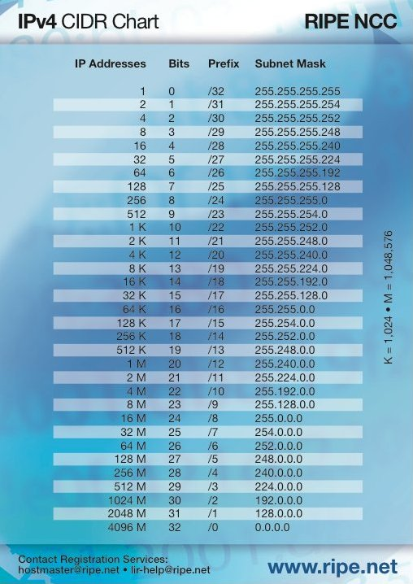
Data Communications for a Global Environment
Classless addressing
CIDR Classless-Inter Domain Routing

Slide 24
Data Communications for a Global Environment
Public vs Private IP addressing
Class A 10.0.0.0 – 10.255.255.255
Class B 172.16.0.0 – 172.31.255.255
Class C 192.168.0.0 – 192.168.255.255
169.254.0.0 – 169.254.255.255
Not accepted by Internet
Routers
Reserved for
automatic IP addressing

Slide 25
Data Communications for a Global Environment
Private IP addressing can provide additional
IP addresses by using Network Address Translation
technology. (NAT proxy server)
IP = 192.168.10.101
SM = 255.255.255.0
Client 1
The Cloud
IP = 192.168.10.102
IP=192.168.10.200
SM = 255.255.255.0
Client 2
IP=131.107.56.103
NAT
Proxy Server
Client 3
IP = 192.168.10.103
SM = 255.255.255.0

Slide 26
Data Communications for a Global Environment
Other IP Exceptions
The first Octet cannot be 127. This is reserved for Diagnostics
127.0.0.1 is the loopback address.
The Host ID’s cannot be all 0’s or all 255’s
All 0’s is the Network ID
All 255’s is the Broadcast ID

Slide 27
Data Communications for a Global Environment
How do we know what part is which?
32 Bit Address
130.160.86.246
Network ID
Host ID

Slide 28
Data Communications for a Global Environment
The Subnet Mask
A subnet mask is a way to tell which portion of
the IP address defines the Network ID and which
portion defines the Host ID.
The IP address is always paired with its Subnet
mask.

Slide 29
Data Communications for a Global Environment
The Subnet Mask shows where the separation
line is.
130.160.86.246
Network ID
255.255.255.0
Host ID
Every IP address will have a subnet mask it is not
an option.

Slide 30
Data Communications for a Global Environment
Subnetting
Subnetting is the process of taking a large network
and dividing it into a smaller network.
Performance
Common shared resources or data

Slide 31
Subnets
Data Communications for a Global Environment
Group of computers on the same LAN with IP numbers with the same network ID
Assigned addresses that are 8 bits in length
For example:
Subnet 149.61.10.x
Computers in Business (x is between 0 & 255)
Subnet 149.61.15.x
Computers in CS department
Assigned addresses could be more or less than eight bits in length
For example: If 7 bits used for a subnet
Subnet 1: 149.61.10.1-128
Subnet 2: 149.61.10.129-255

Slide 32
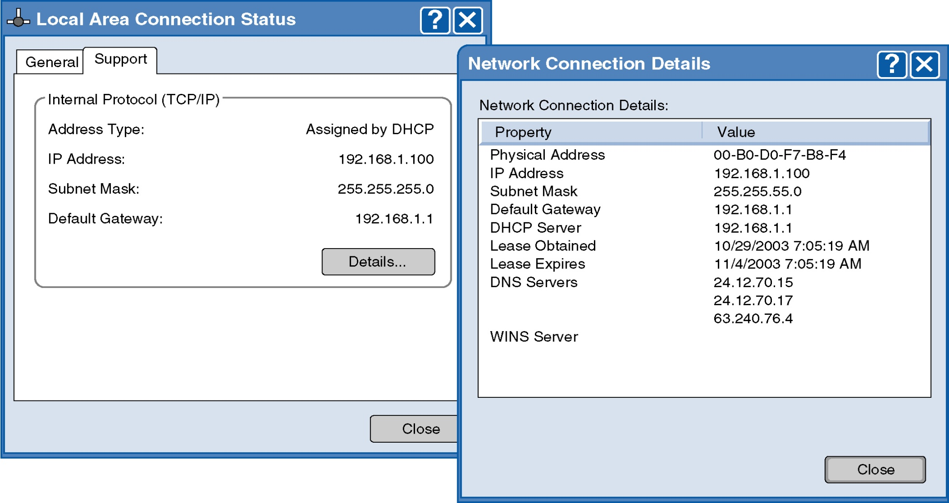
IP Configuration Information
Data Communications for a Global Environment

Slide 33
Subnets: Example
Data Communications for a Global Environment
School of Business
149.61.10.X
149.61.10.50 149.61.10.51 149.61.10.52
149.61.10.6
149.61.254.5
149.61.254.x
GW
GW
Backbone
149.61.254.4
149.61.15.8
149.61.15.50 149.61.15.51 149.61.15.52
School of Engineering
149.61.15.X

